Slide 1
ENGI 301 Wheel Auto-Shuffler Proposal
2/19/2024
Jack Maurry

Slide 2
Background Information
Project Motivation
I Run a weekly poker night with friends and it can be tedious to complete a full shuffle after every hand. Using 2 decks and a handy shuffler device, we could play uninterrupted while our cards receive a perfect shuffle every time (plus it would look super cool)!
Project Overview
52 card auto shuffler able to complete a pseudorandom 52! shuffle after 1 iteration
Project Subassemblies
Single card ejection system
52-slotted wheel able to rotate to each position
Consistent deck recollection method
Computer algorithm to ensure unique slot order for every shuffle
Separate algorithm utilizing camera input and computer vision to modify outcome of shuffle

Slide 3
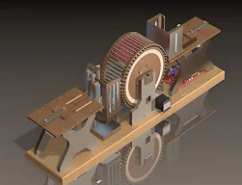
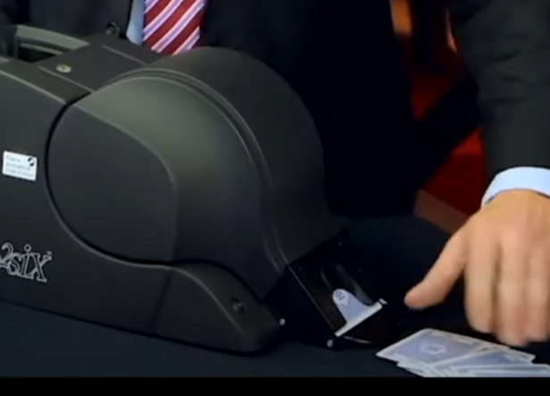
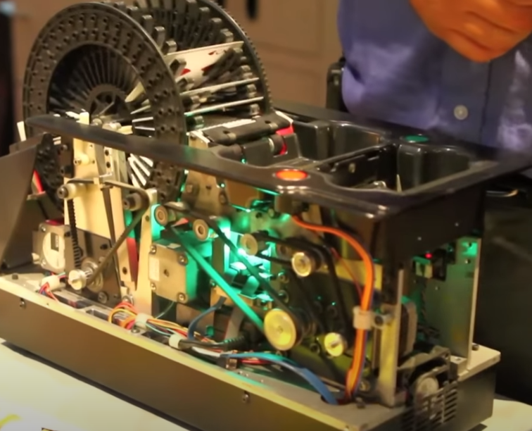
Existing / Inspirational Projects
Blackjack Auto Shuffler (Common in Casinos):
Function as computer-shuffled blackjack shoe.
Fills slotted wheel with cards
Individual card ejection method not fully known
Releases 1 card at a time after dealer pulls card out (cannot release full shuffled deck at once)
Full Deck Auto Shuffler (personal project)
Fill wheel with entire deck then capture cards from each slot
This particular version uses a thin slot with a card attached to a pusher to force individual cards out
https://www.youtube.com/watch?v=Jej-r1I5Odc

Slide 4
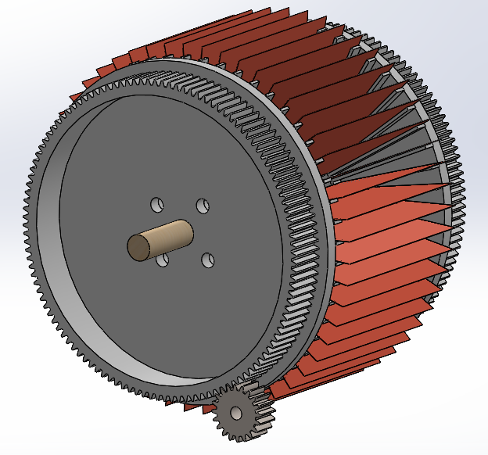
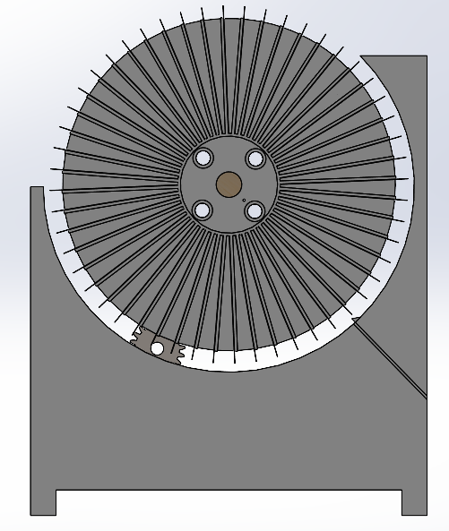
Improvement / Additions / Differences
Single card ejection system
Instead of card pushing design (like from personal project shown), I am working on designing a card ejection system that utilizes a rack and pinion card pushing mechanism
Utilizes 1 servo motor to actuate rack forward and back
Mechanical difference / improvement
52-slotted wheel able to rotate to each position (Mechanical improvement)
3D printed wheel design instead of wood
Full gear implemented into sides of wheel to allow smoother rotation to various slots
Consistent deck recollection method (Mechanical improvement)
Gravity-based collection method of deck from loaded wheel to decrease complexity
Algorithm to ensure unique slot order for every shuffle (Software & Electrical improvement)
Pseudorandom card load input into wheel, followed by linear card output through gravity-based deck collector
Algorithm utilizing camera input and computer vision to modify outcome of shuffle (Software improvement)
Camera system mounted next to card ejection system
Image processing software to clean data to determine value and suit of card
User interface to determine desired output of deck from user input (Aces at 5th and 10th position from top of deck, etc.)
Software to create modified shuffle to ensure final deck output is identical to user desire

Slide 5
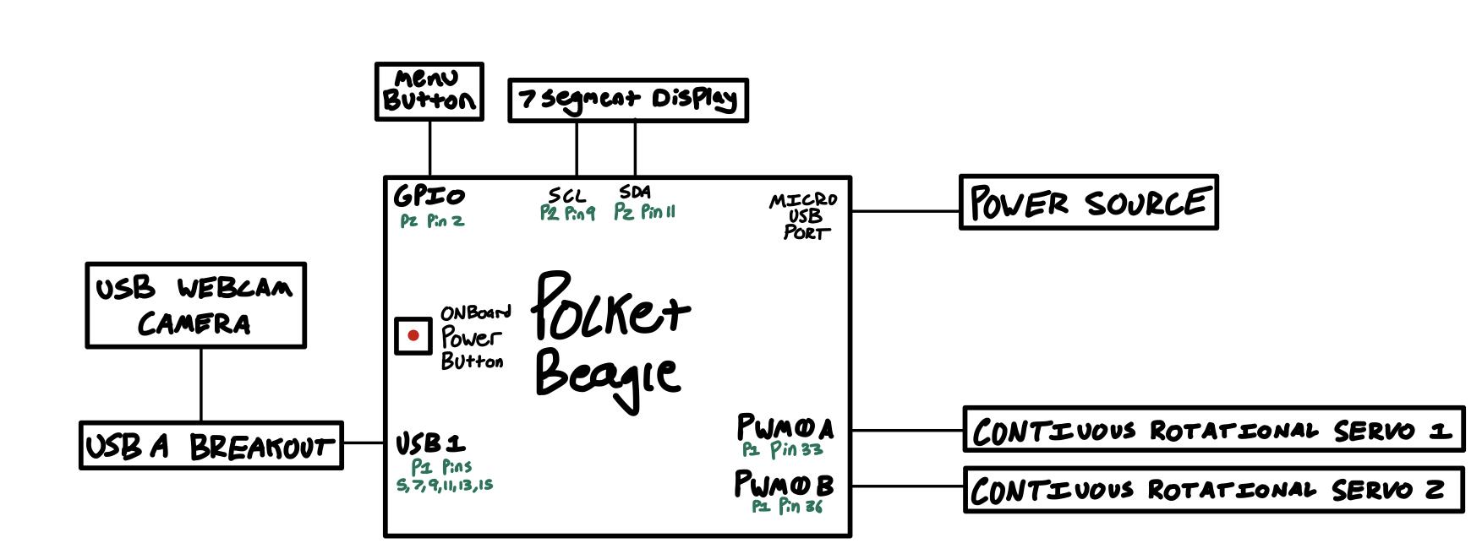
System Block Diagram

Slide 6
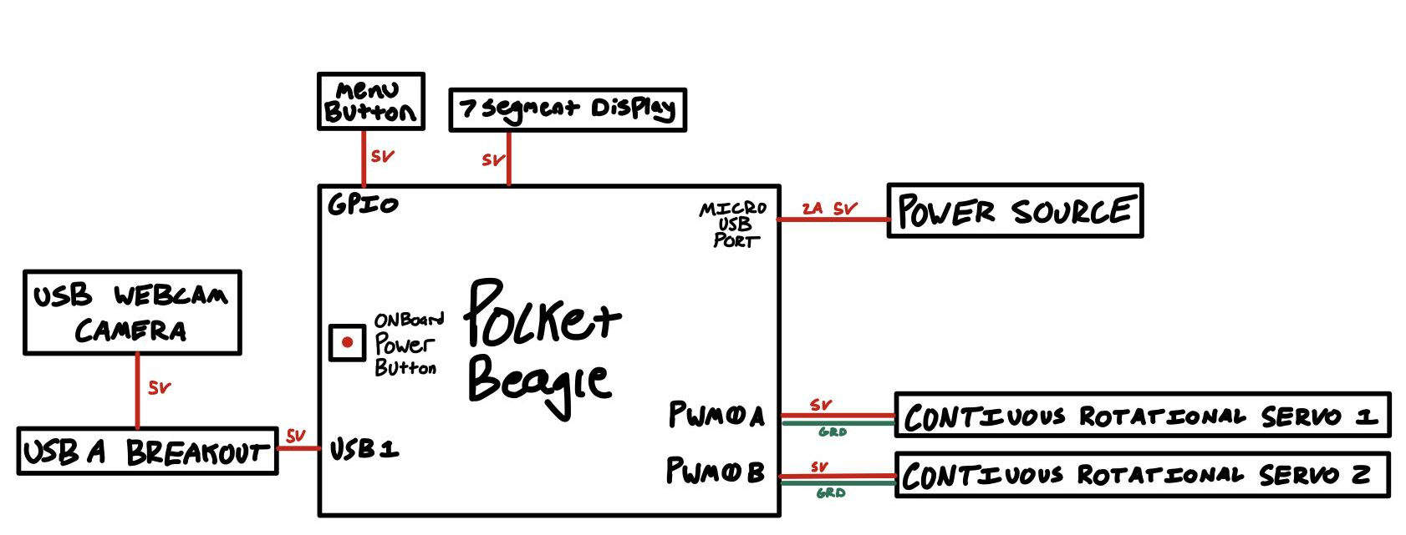
Power Block Diagram

Slide 7
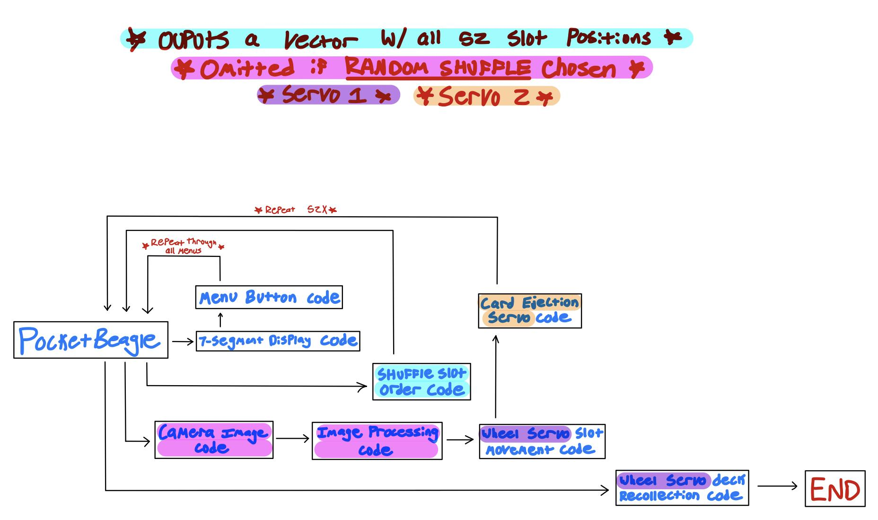
Coding Block Diagram

Slide 8
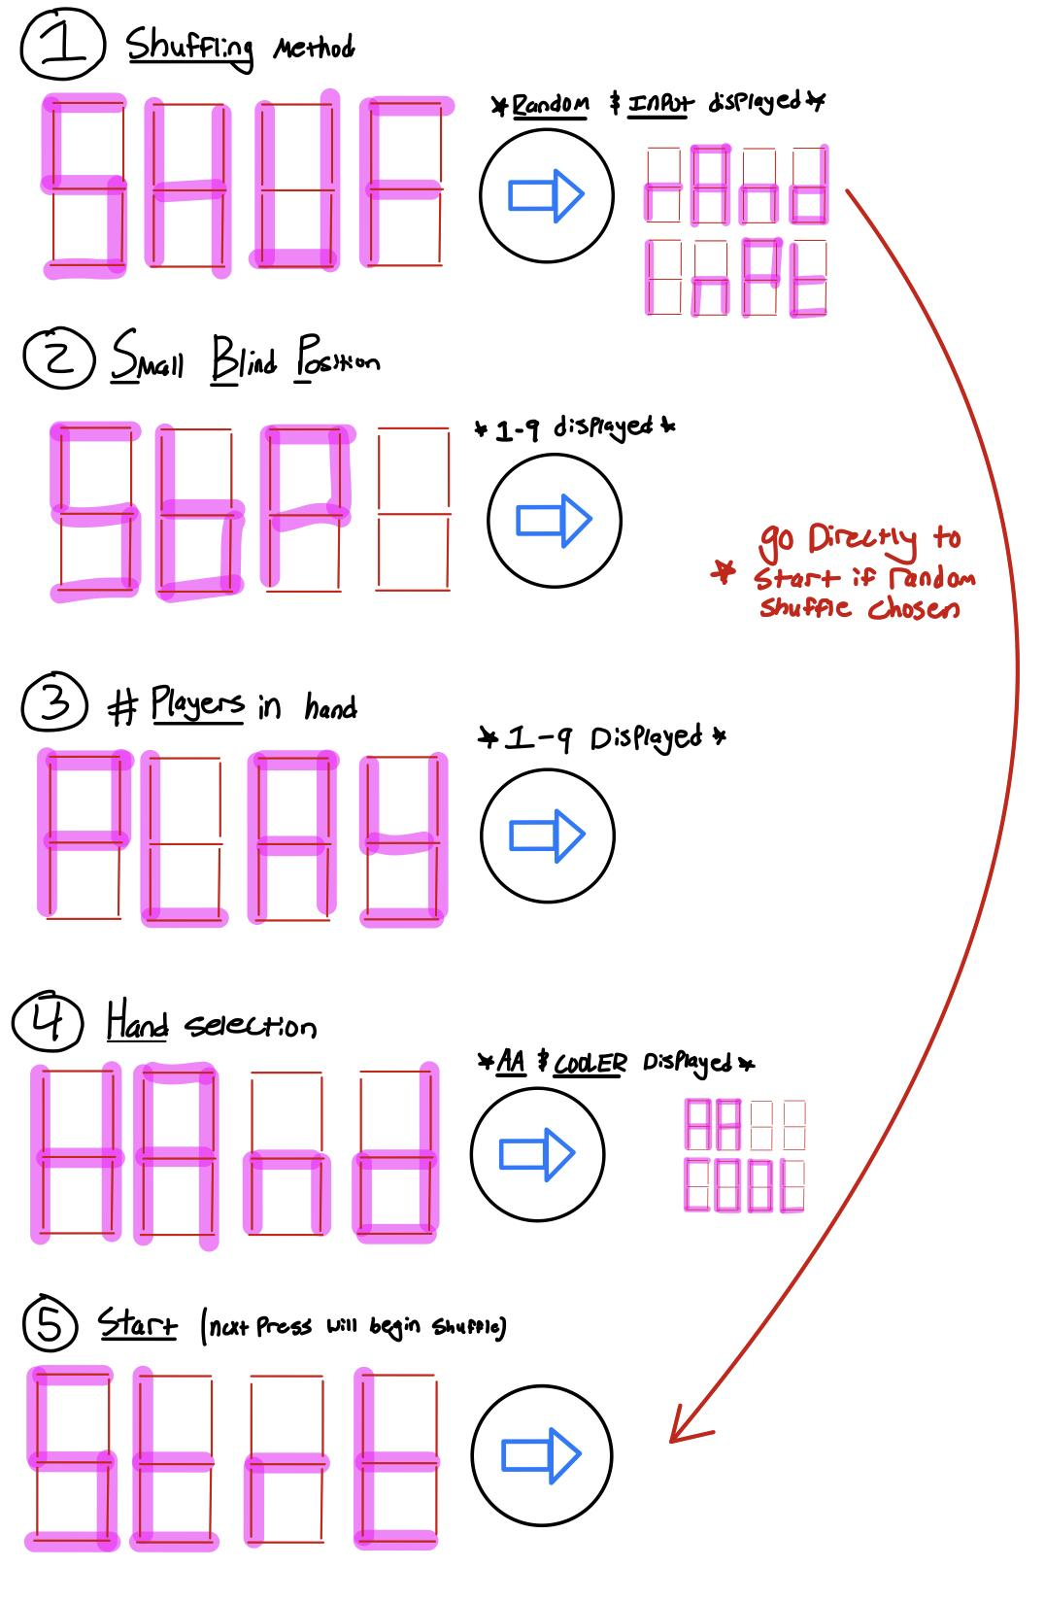
User Interface
7 segment display and button to scroll through various menus
1) Shuffling Method:
Random Shuffle or User-Defined Shuffle
If Random Shuffle Chosen → Skip to menu 5 [START]
2) Small Blind Position:
# of slots you are from the small blind (from your left)
3) Players In Hand:
# of players in the hand
4) Hand Selection:
AA = Aces
COOL = “Cooler” [aka: AA vs. KK]
5) Start:
Next press will begin shuffle

Slide 9
Components / Budget
Component | ENGI301 to Buy? | Cost
continuous servo motor (2) | Yes | $10.80
Image recognition Camera (1) | Yes | $20
USB Breakout Board (1) [Adapters Required Too] | No | $1.95
Menu Button (1) | No
7 Segment Display (1) | No
PocketBeagle (1) | No

